Slide 1


DEPARTMENT OF ECE · MACHINE LEARNING · A.Y. 2026-27
Temporal Fusion Transformer-Based Multi-KPI Forecasting for Proactive Open RAN Control
Project Review Presentation
Presented by
Under the guidance of
Chandra Nikhilesh | 2520040091
Sujeeth Reddy | 2520040025
Sai Charan | 2520040021
<Guide Name>
<Designation, Department>

Slide 2



Problem Statement
Open RAN makes the radio network open and programmable through RAN Intelligent Controllers (RICs). Network KPIs still change constantly with traffic, mobility and radio conditions.
Highly dynamic KPIs
Reactive control is late
Isolated KPI models
Throughput, latency, packet loss, PRB utilisation and active users vary sharply over time and between cells.
Today’s control acts only after congestion or QoS degradation is detected, so users are already affected.
Forecasting one KPI at a time ignores the strong coupling between load, resources and QoS.
Goal: Jointly forecast multiple KPIs several steps ahead with a Temporal Fusion Transformer, so the RIC can act before degradation happens.
TFT Multi-KPI Forecasting for Proactive Open RAN Control | 2 / 10

Slide 3
Methodology: Temporal Fusion Transformer
Static
Cell ID embedding
Variable Selection
Networks
LSTM Encoder–
Decoder
Multi-Head
Attention
Quantile
Output
Past observed
5 KPIs, last 12 h
Learn which inputs matter at each step
Captures local temporal patterns
Long-range dependencies, interpretable weights
P10 / P50 / P90 for all 5 KPIs
Known future
Time of day, day of week, weekend
Gated Residual Networks (GRN) and gating layers wrap every block and suppress unneeded components.
Why TFT?
Multi-horizon, multi-variate forecasts in a single model
Uses known future inputs (calendar/time) alongside past KPIs
Interpretable: variable importance and attention show why a forecast was made
Quantile outputs give uncertainty bands for risk-aware control
TFT Multi-KPI Forecasting for Proactive Open RAN Control | 3 / 10

Slide 4
Algorithm: Forecast-Driven Proactive Control
1
Input
Sliding window of the last 48 steps (12 h, 15-min interval) of 5 KPIs plus time covariates for each cell
2
Normalise
Z-score scaling using training-set statistics only
3
Forecast
TFT predicts the next 12 steps (3 h) for all KPIs at quantiles q = 0.1, 0.5, 0.9
4
Train
Minimise quantile (pinball) loss L = Σ max(q·e, (q−1)·e), where e = y − ŷ
5
Decide
If predicted P90 PRB utilisation or latency crosses a threshold → raise an early alert
6
Act
RIC xApp adjusts PRB allocation, load balancing or handover policy ahead of time
TFT Multi-KPI Forecasting for Proactive Open RAN Control | 4 / 10

Slide 5






Project Workflow & Implementation
Data collection / simulation
Pre-processing
Window generation
TFT training
Multi-step forecasting
Proactive control
Per-cell KPI time series
Cleaning, scaling, time features
12 h input → 3 h output
Quantile loss, early stopping
5 KPIs with P10/P50/P90
Alerts and RIC policy actions
Where it runs in O-RAN
Non-RT RIC (rApp)
Near-RT RIC (xApp)
E2 nodes (O-CU / O-DU)
Offline training and periodic re-training on KPI history (> 1 s loop)
Online inference and control actions (10 ms – 1 s loop)
Report KPIs over E2 and apply the chosen policy
Tools: Python 3, PyTorch, NumPy / pandas, scikit-learn, Matplotlib, Google Colab / Jupyter
TFT Multi-KPI Forecasting for Proactive Open RAN Control | 5 / 10

Slide 6
Simulation Setup
12
28
5
48 → 12
O-RAN cells
days @ 15-min
KPIs forecast
steps in → out
Dataset | Simulated per-cell KPIs: daily and weekly traffic cycles, random traffic bursts, congestion-coupled latency and packet loss
KPIs | Throughput (Mbps), latency (ms), packet loss (%), PRB utilisation (%), active UEs
Split | Chronological 70 / 15 / 15 % → train / validation / test (4,716 test windows)
TFT model | Hidden size 48, 4 attention heads, ≈ 313 k parameters, Adam, 20 epochs, best-validation checkpoint
Baselines | Persistence (last value), seasonal naive (same time yesterday), 2-layer LSTM
Metrics | MAE, RMSE, MAPE per KPI; prediction-interval coverage
TFT Multi-KPI Forecasting for Proactive Open RAN Control | 6 / 10

Slide 7
Results: Forecast Accuracy
MAE per KPI (3-h horizon average)
KPI | TFT | LSTM | Persist.
Throughput (Mbps) | 16.36 | 17.47 | 25.56
Latency (ms) | 0.91 | 0.94 | 1.34
Packet loss (%) | 0.024 | 0.025 | 0.034
PRB util. (%) | 7.98 | 8.51 | 12.11
Active UEs | 5.56 | 5.97 | 8.76
33 % lower error than persistence and 4.5 % lower than LSTM. TFT gives the lowest MAE on every KPI, and RMSE follows the same trend.
TFT Multi-KPI Forecasting for Proactive Open RAN Control | 7 / 10

Slide 8
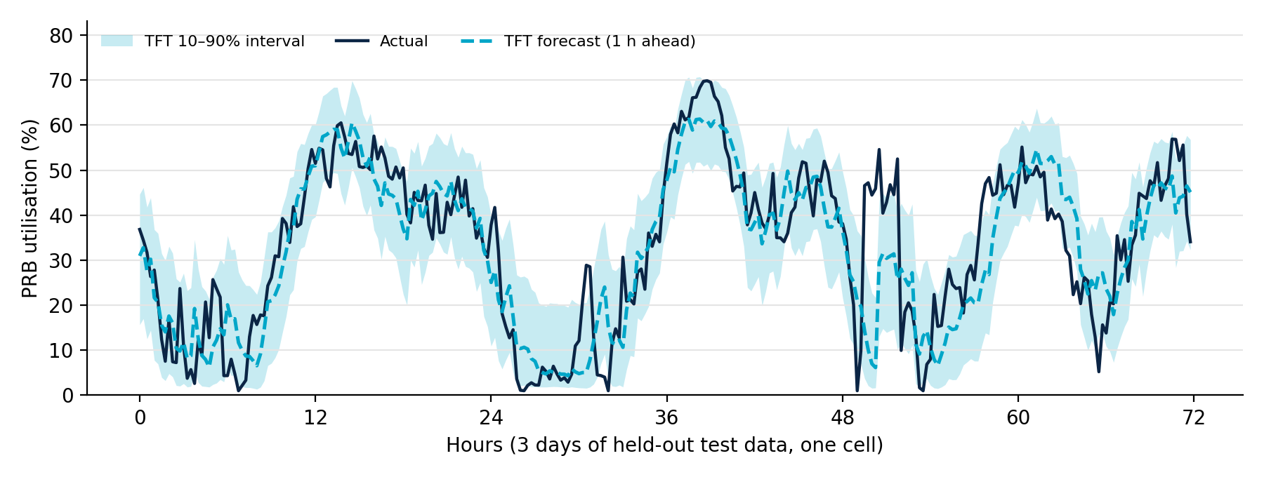
Results: Forecast Behaviour & Interpretability
PRB utilisation, 1-h-ahead TFT forecast vs actual on unseen test data
79.6 %
−42 %
Time of day
of actual values fall inside the P10–P90 band (target 80 %), so the uncertainty is well calibrated
error vs persistence at the 3-h horizon; TFT degrades slowest as the horizon grows
is the most important input (39 % VSN weight), followed by throughput (13 %) and PRB (11 %)
TFT Multi-KPI Forecasting for Proactive Open RAN Control | 8 / 10

Slide 9


Current Progress & Remaining Work
Completed
Remaining
Literature review on O-RAN, RIC and time-series forecasting
Multi-KPI O-RAN traffic simulator built
Pre-processing and sliding-window pipeline
TFT implemented and trained with quantile loss
Baselines (persistence, seasonal naive, LSTM) compared
Accuracy, horizon and interpretability analysis
Validate on a real / testbed O-RAN KPI dataset
Hyperparameter tuning and ablation (without attention / VSN)
Build the proactive control module (threshold alerts to PRB and load-balancing actions)
Evaluate early-warning lead time and precision on congestion events
Package as an xApp prototype and write the final report
TFT Multi-KPI Forecasting for Proactive Open RAN Control | 9 / 10

Slide 10
Conclusion
A single TFT model forecasts 5 O-RAN KPIs up to 3 h ahead, with calibrated uncertainty.
On simulated data it beats persistence by 33 % and LSTM by 4.5 %, with the widest gain at longer horizons.
Interpretable outputs show why a forecast was made, which builds operator trust.
Next: real-data validation and closing the loop with RIC control actions.
Thank You
Questions & discussion

